Slide 1
MGPG – Group 7
George Heath-Collins, Brad Pablo, Katie Millar and George Croucher

Slide 2
Goals of the Brief
Game must be 2D
Controlled by tapping
Turn-based multiplayer
Competitive
Single Device (mobile)
Symmetric and simple to play
Designed for Casual Gamers

Slide 3

Research
Developed by 1 person in 2-3 days
Gain points by progressing past pipes
Simple flight mechanic
Controlled by a tap
Its simplicity appeals to a wide audience

Slide 4

Research
Mobile Platformer
Jumping mechanic
Players avoid obstacles
Controlled by a tap
Simple graphics
Appeals to competitive and challenge seeking players

Slide 5
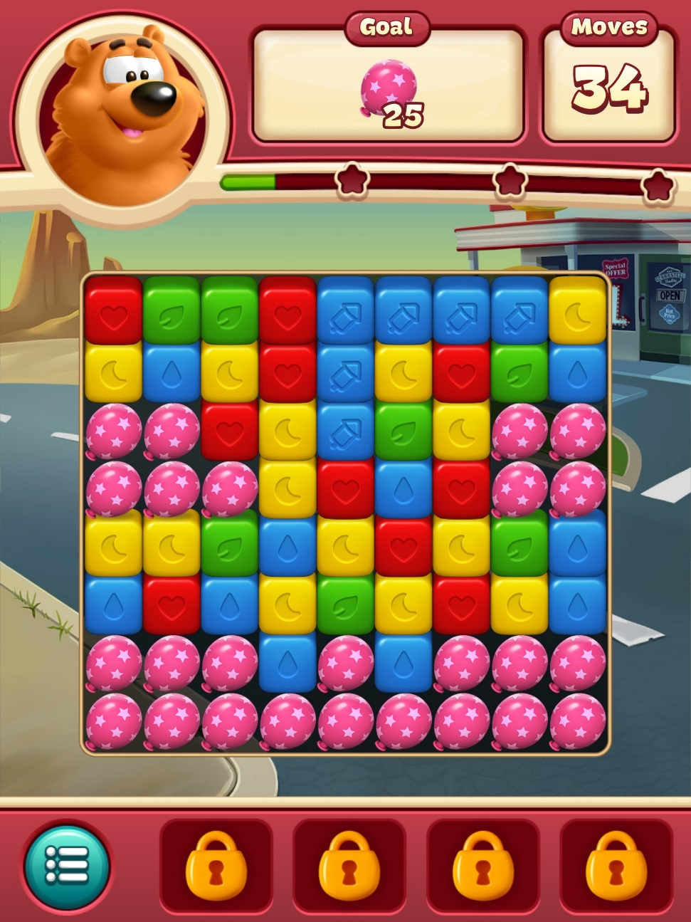
Research
Tile-matching puzzle game
Players are given a set number of moves
Simple, colourful art-style with cartoon characters
Easy and intuitive controls
Easy to pick up and play
Appeals to wide demographic

Slide 6
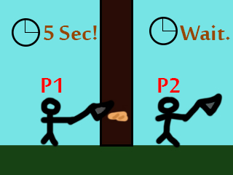
Our Pitch
Multiplayer. Players take on the role of rival lumberjacks with very bad stamina, who take short turns swinging an axe at a tree.
The unlucky lumberjack who manages to cut down the tree will be crushed by it.
Health and Safety isn’t important.

Slide 7
How does the game meet the brief?
The game is displayed in 2D, with each player having a different side.
It is a competitive, turn-based game.
It uses a single device for local multiplayer.
It is designed primarily for Casual Gamers on mobiles.
Symmetric in both layout and gameplay.
Controlled using a single tap.

Slide 8
How will it be achieved? (Programming)
First bullet point here
Second bullet point here
Third bullet point here

